Slide 1


presents
Financial Support to MSMEs in ZED Certification Scheme
in association with
National Monitoring and Implementing Unit (NMIU)

Slide 2
WELCOME & INTRODUCTION
Source:

Slide 3

Objectives of the programme
Objectives:
Introduction of the ZED scheme
Introduction to ZED Rating & Certification Process including broad overview of the ZED Maturity Assessment Model
Q & A
Registration on ZED Portal
Understanding Online Self Assessment & other stages

Slide 4
Quality Council of India
The Quality Council of India (QCI) is an autonomous body set up by Ministry of Commerce & Industry, Government of India
The Mission of QCI is to lead nationwide quality movement in India with emphasis on adherence to quality standards in all spheres of activities
The Secretary General of QCI is appointed by the Minister of Commerce & Industry and the Chairman is appointed by the Prime Minister of India on recommendations of the industry

Slide 5

The ZED VIDEO

Slide 6
BASIC FACTS OF THE SCHEME
VOLUNTARY SCHEME
FOR MANUFACTURING MSMEs
UAM ESSENTIAL FOR AVAILING SUBSIDY
CERTIFICATION ON SYSTEMS & PROCESSES
MODEL PREPARED BY QCI

Slide 7

WHAT IS ZED
ZERO DEFECT ZERO EFFECT
a unique & holistic Maturity Assessment Model for Micro, Small and Medium Enterprises (MSMEs)
Includes Assessment, Rating and Handholding
50 well defined Parameters of production, design, quality, safety, environment, etc.
Minimum 30 out of 50 parameters, including 20 mandatory parameters to be assessed
Additional 25 parameters for MSMEs supplying to Defense Sector

Slide 8
ZED Defence Model
To cater the need of defence industries,
QCI has developed a holistic ZED defence Model.
→QCI has integrated another 25 parameters specifically designed to measure MSME performance in defence sector.
These 25 parameters will be additional to 30 parameters from the generic ZED model.
Additional Disciplines for ZED Defence
Defence Outreach
Technology specific to defence
Risk Assessment
Defence Quality System
Financial Discipline
Security, Safety & Confidentiality
Post delivery and customer feedback
Design Discipline

Slide 9
ZED DISCIPLINES
Production Management
Energy Management
Safety Management
Quality Management
Environment Management
1
2
3
4
5

Slide 10
ZED DISCIPLINES
Natural Resource Management
Design Management
Overall Company Performance
Intellectual Property Management
Human Resource Management
6
7
8
9
10

Slide 11
Major Interventions covered in ZED Parameters

Slide 12
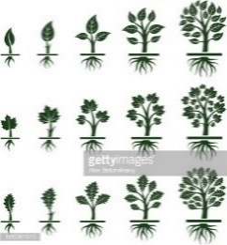

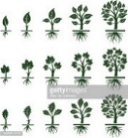
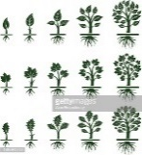

ZED MATURITY LEVELS
Each parameter comprises of 5 Maturity levels
Level 1 (0 Marks)
Learner
Level 2 (2 Marks)
Beginner
Level 3 (3 Marks)
Organized
Level 4 (4 Marks)
Achiever
Level 5 (5 Marks)
World Class

Slide 13
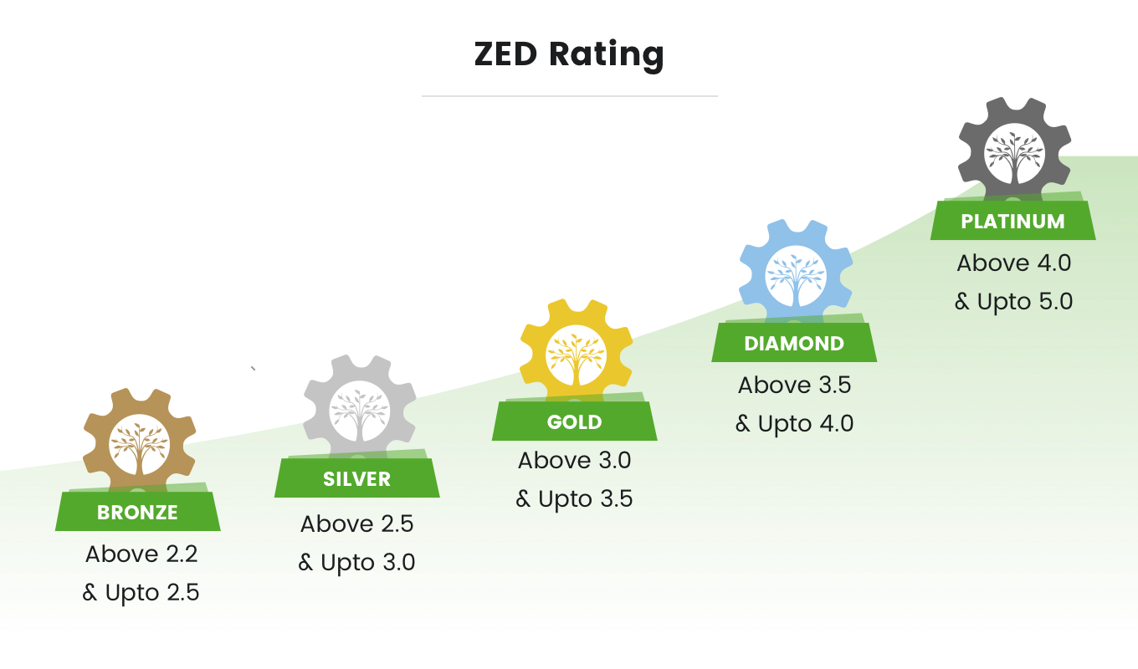
=<2.2 No rating

Slide 14
Q&A
QUESTIONS & ANSWERS

Slide 15
ON THE SPOT REGISTRATIONS Subsidy scheme is open to only 22,222 MSMEs Please register Now !

Slide 16
www.zed.org.in
ZED Registration & Online Self Assessment

Slide 17
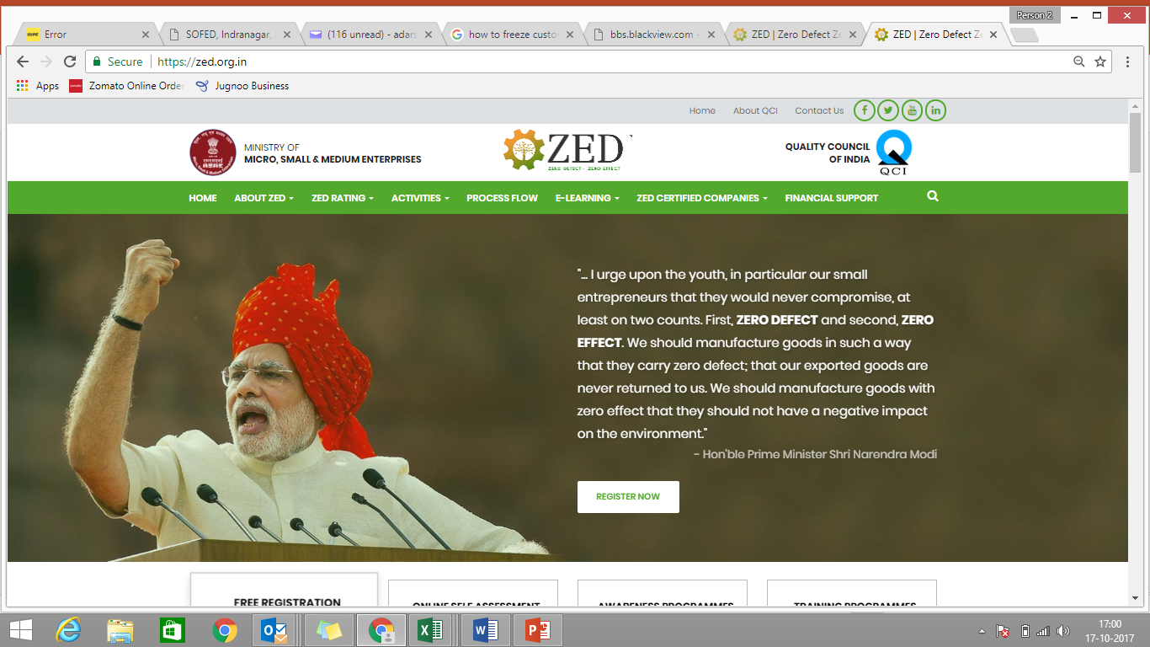

www.zed.org.in
ZED Registration

Slide 18
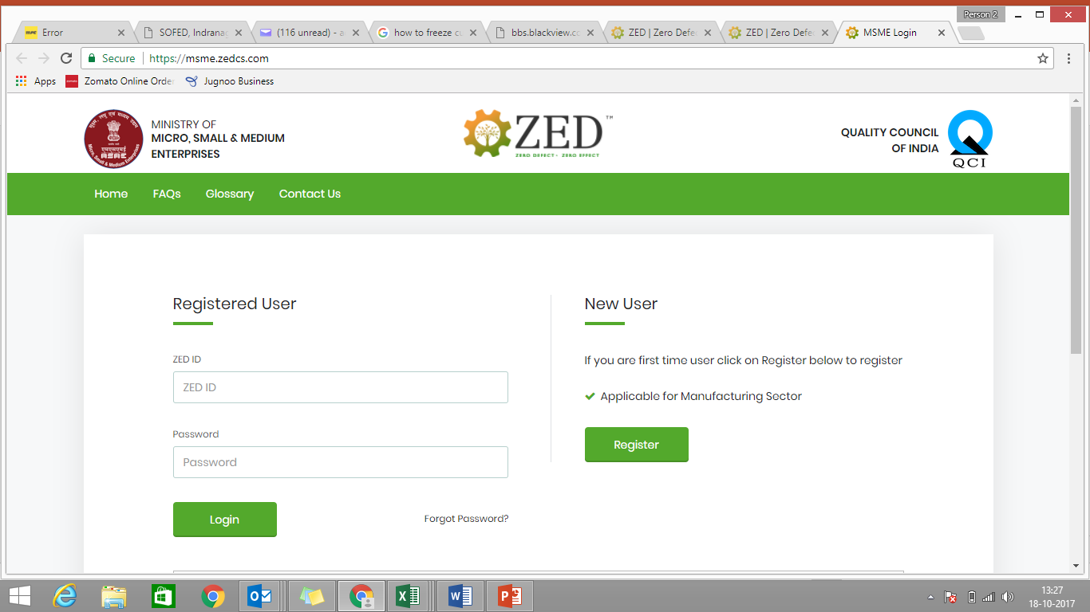
ZED Registration
Registration

Slide 19
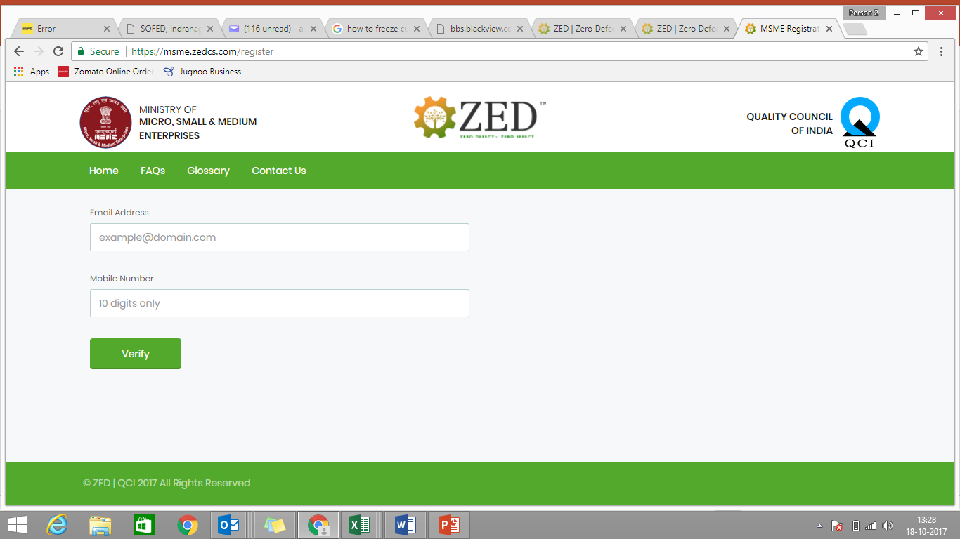
ZED Registration
Enter your email ID and Indian Mobile Number

Slide 20
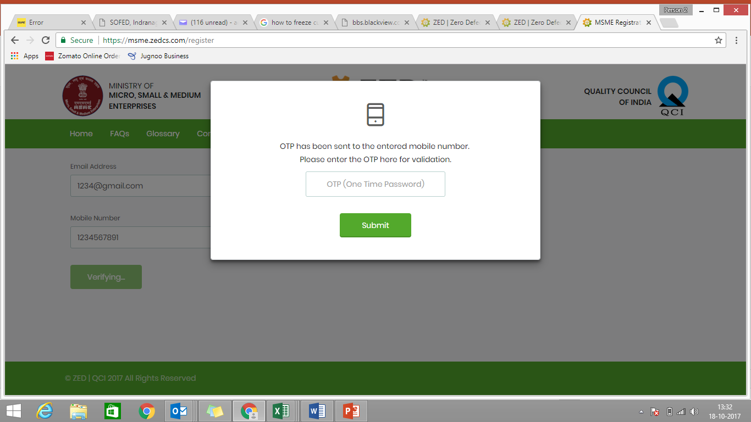
ZED Registration
Enter OTP
received
on phone

Slide 21
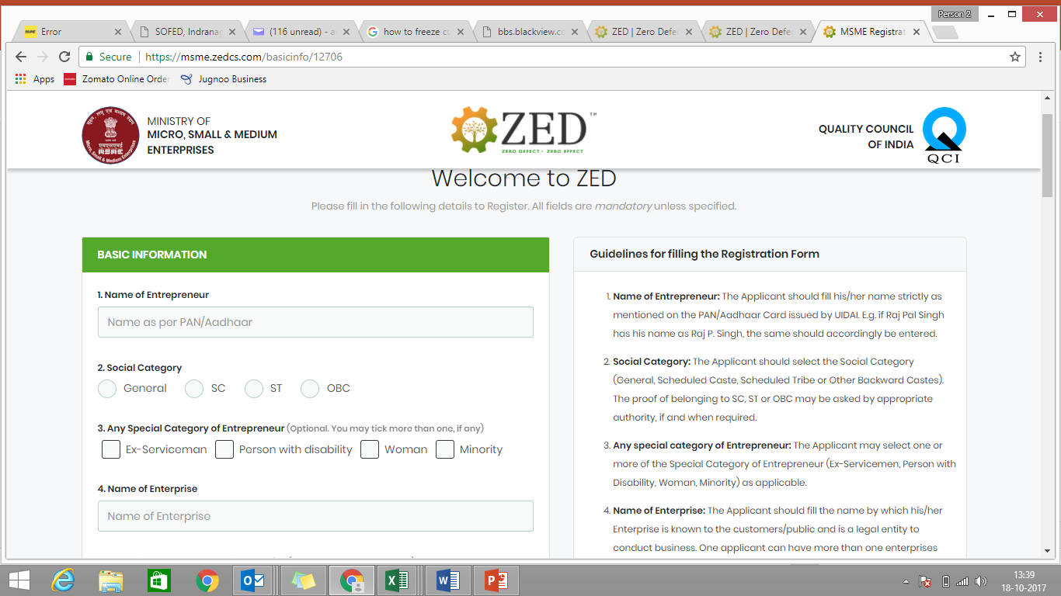
ZED Registration
Complete Registration Details

Slide 22
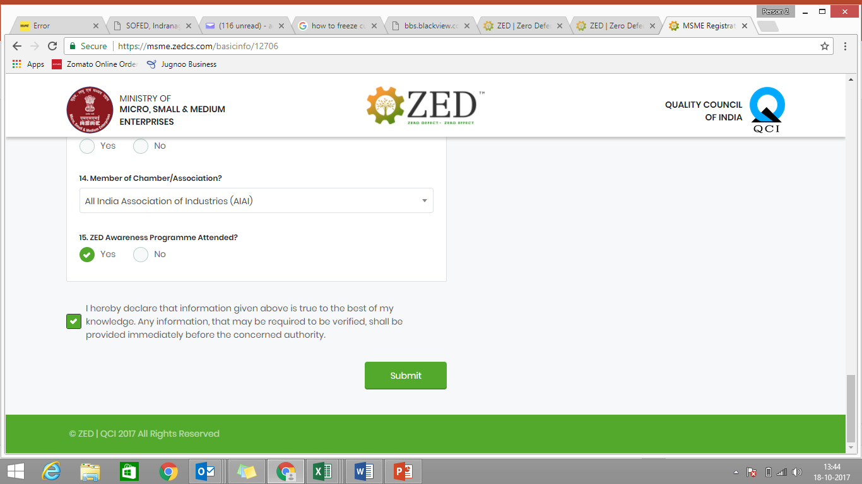
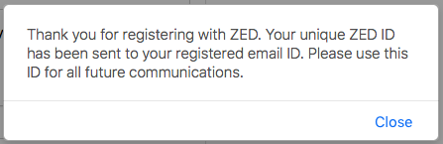
ZED Registration
Receive ZED ID & Password on Email
Submit after completing Form

Slide 23
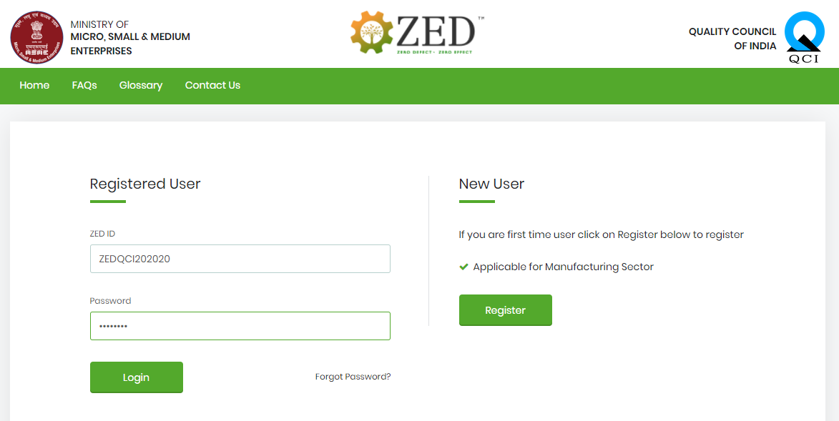
ZED Registration
To start Online Self Assessment, Login with ZED ID & Password received on Email

Slide 24
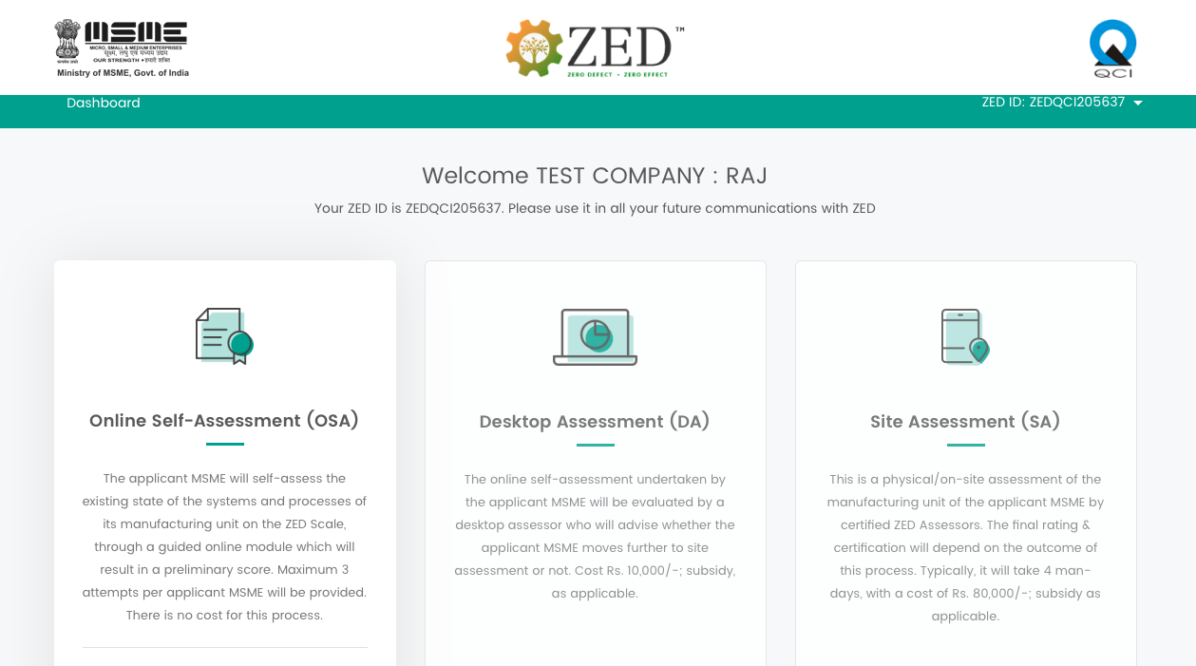
ZED Online Self Assessment
Start OSA

Slide 25
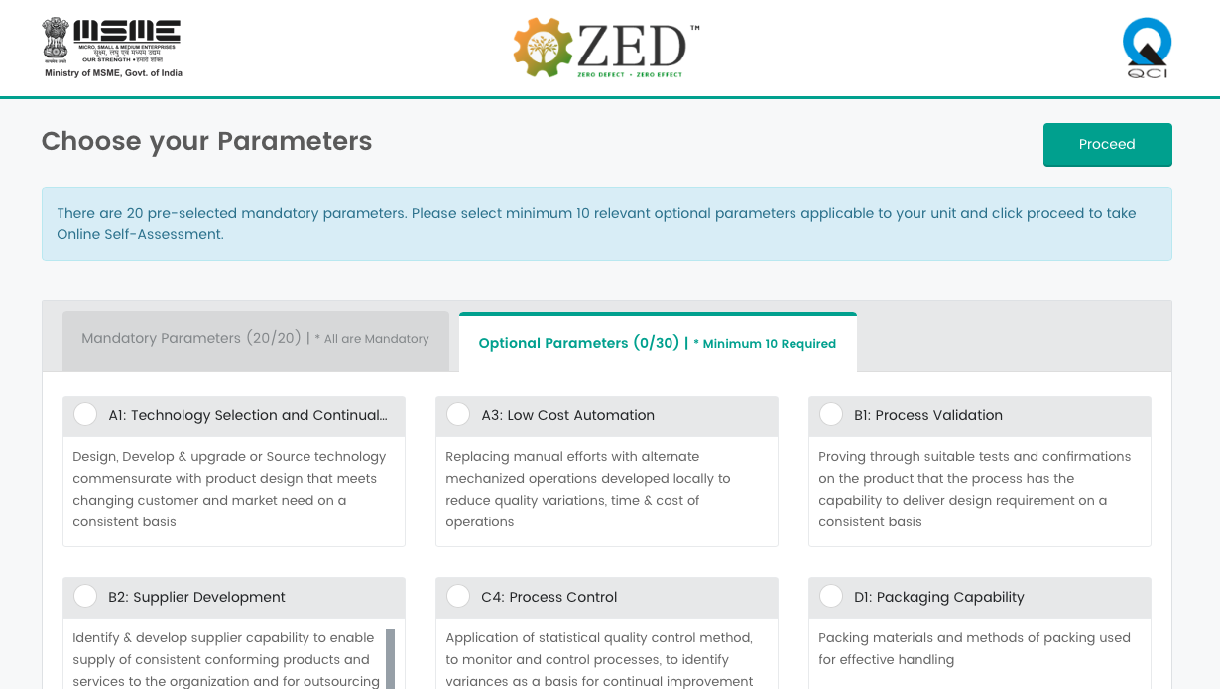
ZED Online Self Assessment
Then Proceed
First select minimum 10 applicable parameters

Slide 26
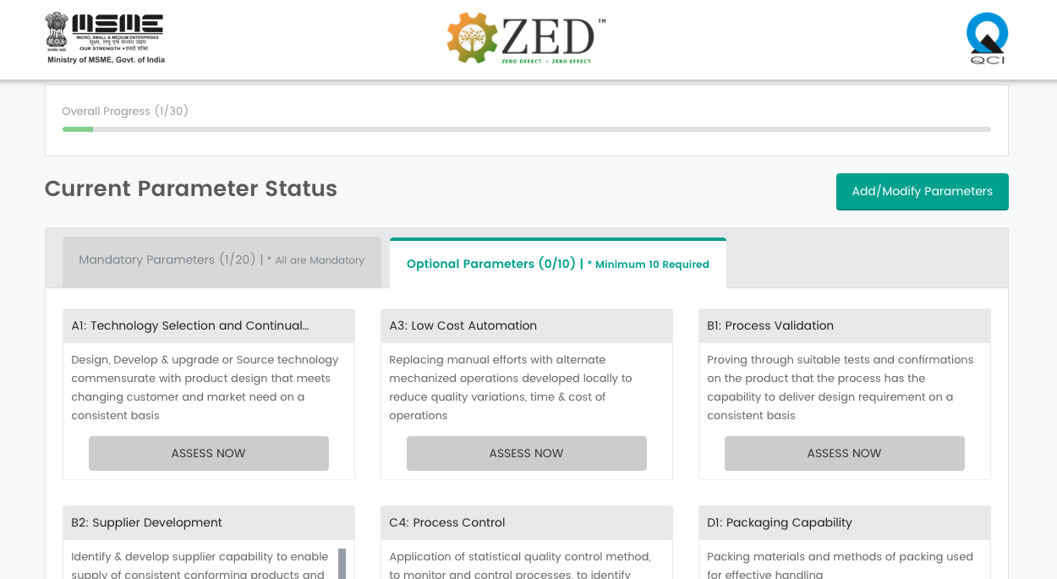
ZED Online Self Assessment
Attempt Assessment for all mandatory & selected optional parameters

Slide 27
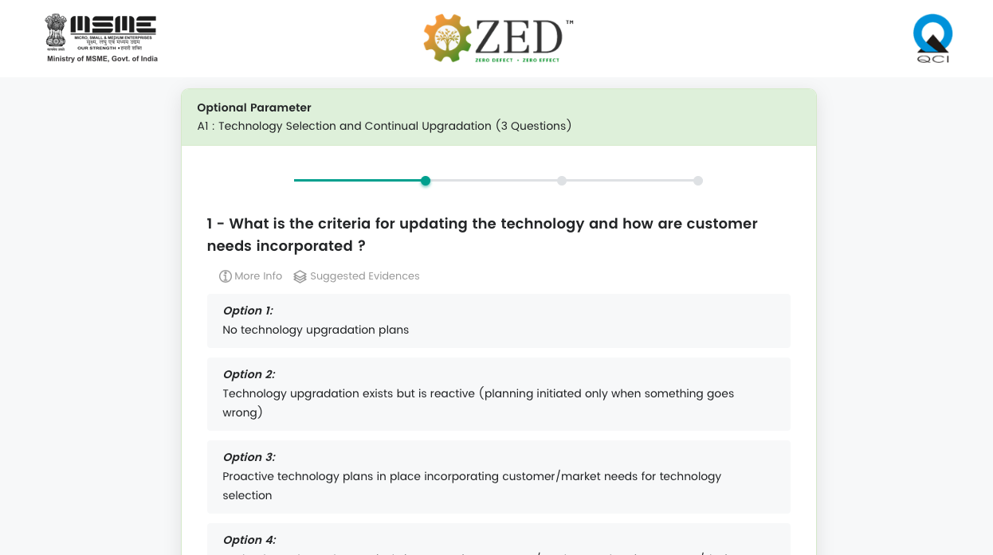
ZED Online Self Assessment
Select the option closest to your existing practice and submit

Slide 28
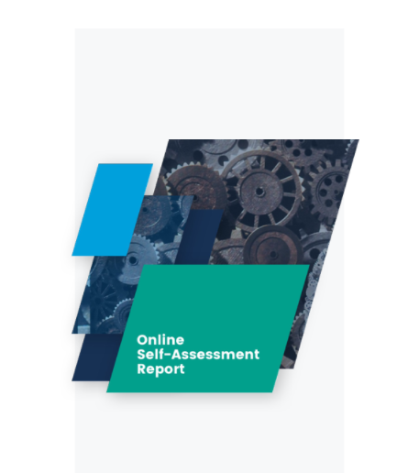
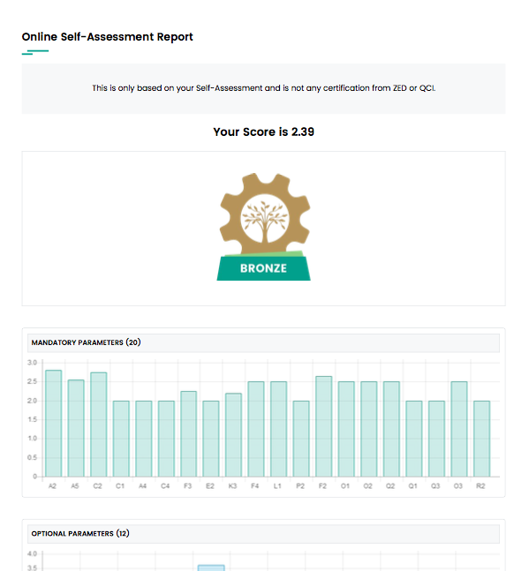
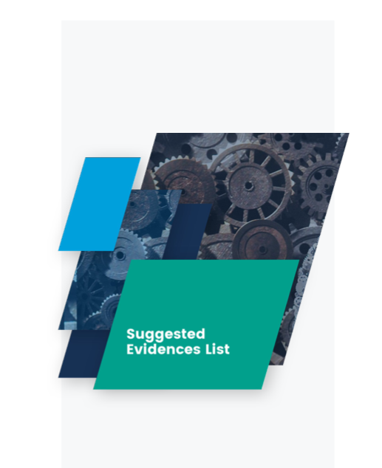
ZED Online Self Assessment
Attempt self-assessment on all selected parameters and then Submit
After submission, you will receive a report on your email
Along with a list of suggested evidences that will be needed for Desktop Assessment stage

Slide 29
Slides for Back up

Slide 30
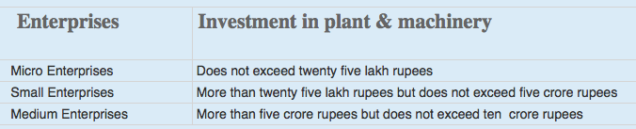
A few basic facts (1/2)
This is a voluntary scheme and is applicable to Micro, Small & Medium Enterprises – Manufacturing Sector only. QCI has been nominated as the NMIU of the scheme.
Certification after assessment of a Manufacturing Unit’s systems & processes based on ZED Parameters.
An MSME WILL NOT BE ELIGIBLE to go for ZED Certification if the legal & regulatory compliances are not followed.
Definitions of Micro, Small & Medium Enterprises is in accordance with the provision of MSMED Act, 2006.
Manufacturing Enterprises are enterprises engaged in the manufacture or production of goods pertaining to any industry specified in the first schedule to the industries (Development and Regulation Act, 1951) or employing plant and machinery in the process of value addition to the final product having a distinct name or character or use. The Manufacturing Enterprise are defined in terms of investment in Plant & Machinery.

Slide 31
A few basic facts (2/2)
The generic model for Service Sector has been made and a pilot project to test and evolve the model is under consideration by DIPP, MoCI
Though Large industries are not covered in this scheme, the model is applicable across all sectors and size
An MSME must be registered under the UAM (Udyog Aadhaar Memorandum) to avail the benefits under the ZED scheme. Registrations under UAM are free. It may be noted that the Ministry has not appointed any representative for Udyog Aadhaar Registration.
UAM is a one-page simple registration form for online filing of UAM which replaces the filing of Entrepreneur’s Memorandum Part I & II. The filing of UAM can be done on http://udyogaadhaar.gov.in
Registration is online and user-friendly
UAM can be filed on self-declaration basis
No documentation required
No Fee for filing
File more than one Udyog Aadhaar with same Aadhaar Number.

Slide 32
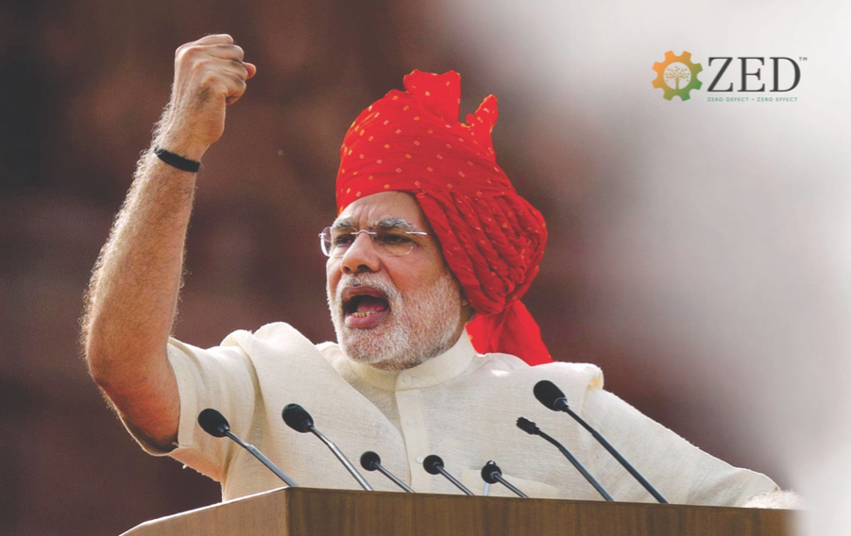
GENESIS OF THE SCHEME
“
“Our manufacturing should have
ZERO DEFECT so that our products should not be rejected in the global market. We must also keep in mind that our manufacturing is done with
ZERO EFFECT so that it does not have any negative impact on our environment.”
- August 15, 2014

Slide 33
The Scheme
Name
FINANCIAL SUPPORT TO MSMEs IN ZED CERTIFICATION SCHEME
The Scheme is an extensive drive of the Ministry of MSME, Government of India, to enhance global competitiveness of MSMEs by providing them financial support in assessment, rating and handholding of its manufacturing processes on Quality and Environment aspects
For: 22,222 MSMEs
BUDGET OF THE SCHEME: Rs. 491 Crores

Slide 34
Scheme governance
Routine functionalities
SSC chaired by Development Commissioner of MSME to guide, review, monitor and provide overall direction for implementation of the scheme
Quality Council of India (QCI) to function as the NMIU for the scheme
Overall guidance and direction
Screening and Steering Committee (SSC)
Chaired by DC-MSME
Facilitation, Implementation, Coordination and Monitoring
National Monitoring and Implementing Unit (NMIU)
QCI
Implementing Agencies
Rating & Other Agencies
Consultants & Consulting Bodies

Slide 35




Methodology
Awareness and training
Through Implementing Agencies like QCI, NPC, Chambers, MSME-DIs, MSME Technology Centers, Industry Associations, BEE, etc.
To develop e-learning modules for capability building
Third party site-assessment
Assessments by Certified Assessors of accredited Credit Rating Agencies, and other accredited agencies etc.
Online allocation of assessors and monitoring of Assessment process
Tab based Site-Assessments
Third party consultancy (gap analysis and handholding)
Consultancy by Certified Consultants of accredited Consulting Agencies/Bodies, and Certified Individual Consultants
Online allocation of consultants and monitoring of Consulting process
Tab based reporting of Site-Visits
Certification
Final Rating and Certificates to be issued by QCI

Slide 36

Benefits of ZED Scheme for MSMEs
Credible recognition for international investors seeking investment in India
Part of supply chain of national & international OEMs
Streamlined operations and lower costs
Superior quality, reduced rejection and higher revenues
Increased environmental consciousness and social benefits
“ZED Mark” to enable an MSME to be seen as a company with a difference
Other benefits expected to be announced by the Government in the near future

Slide 37
7 Step Process flow for ZED rating
1
Registration
Online Registration by MSMEs
2
Online Self-assessment
MSMEs to self-assess based on ZED parameters (can be attempted for maximum 3 times)
3
Desktop assessment
Assessment based on documents submitted by MSMEs
7 Steps towards ‘Excellence’
4
Site assessment
On-site assessment of only MSMEs, selected in Desktop Assessment
5
ZED rating & certification
Final ZED rating and certificate (valid for 4 years)
6
Gap analysis & handholding
Option to avail services of gap analysis & handholding
7
Re-assessment
Option to apply for re-assessment
Surveillance: On-site surveillance 2 times in a cycle

Slide 38
Financial Support to MSMEs by Government Micro: 80%, Small: 60%, Medium: 50%
Total Cost
Cost to MSMEs according to its Type
1
Registration & Online Self-assessment
Micro Small Medium
No Cost No Cost No Cost
Registration,
Desktop
Assessment
&
Site-
Assessment
2
Desktop assessment
Rs. 10,000/-
Micro Small Medium
Rs. 2000/- Rs. 4000/- Rs. 5000/-
3
Site assessment
Rs. 80,000/-
Micro Small Medium
Rs. 16000/- Rs. 32000/- Rs. 40000/-
TOTAL ASSESSMENT COST to MSME
Rs. 18000/- Rs. 36000/- Rs. 45000/-
4
Additional Defence Rating
Rs. 40,000/-
Micro Small Medium
Rs. 8000/- Rs. 16000/- Rs. 20000/-
Defence
Assessment,
Consulting
& Re-
Assessment
5
Gap analysis & handholding (optional)
Rs. 1,90,000/-
Micro Small Medium
Rs. 38000/- Rs. 76000/- Rs. 95000/-
6
Re-assessment/Re-rating
Rs. 40,000/-
Micro Small Medium
Rs. 8000/- Rs. 16000/- Rs. 20000/-
Additional Subsidy of 5% for MSMEs owned by SC/ST/Women & MSMEs located in NER and J&K
Certification Costs are included in Site-assessment, Defence Rating and Re-assessment components
Surveillance Fee to be paid by MSMEs will be decided in due course

Slide 39
FINANCIAL ASSISTANCE - Conditions
The full cost of the specific activity will be paid by the MSME before the start of the activity, and the subsidy is provided after completion of that activity and depending on certain conditions as explained below
Activity
Subsidy Details
1
Registration & Online Self-assessment
NO COST to MSME
2
Desktop assessment
Rs. 10,000/-
Subsidy provided to MSME irrespective of outcome
3
Site assessment
Rs. 80,000/-
Subsidy provided to MSME irrespective of outcome
4
Additional Defence Rating
Rs. 40,000/-
Subsidy provided to MSME irrespective of outcome
5
Gap analysis & handholding (optional)
Rs. 1,90,000/-
Subsidy provided to only those MSMEs which have achieved minimum Bronze rating after Site Assessment
6
Re-assessment/
Re-rating*
Rs. 40,000/-
Subsidy provided to only those MSMEs which graduate at least one level from their previous rating, after re-assessment. Eg: No Rating to Bronze, Bronze to Silver etc.
* MSMEs with No Rating after Site Assessment can also go for Re-assessment

Slide 40



Slide 41
Next Steps
If there are still any queries , kindly mail them to:
zed@qcin.org

